Slide 1
Down selecting Potential Concept
Team 1: Shruti, Mihir, Rachana, Patrick, William

Slide 2
Overview
Recap
Downselecting
Conclusion
Quick Recap on our concepts.
We elaborate more on the rationale behind downselecting.
We down select the best concept by measuring different parameters.
Mihir

Slide 3

Original Potential Concepts
A: Biobloom
B: InfiniShop
C: AquaChain
Improving healthcare through technology
Virtual showroom experience with AR Shopping
Blockchain water supply sanitation and management
Problem:
Problem:
Problem:
Inconvenient healthcare
Outdated online shopping
Water sanitation and supply management
Solution:
Solution
Solution
Wireless healthcare monitoring systems
AR - Customers shop & view online products in real time
Blockchain water supply monitoring system
Patrick

Slide 4




Design Parameters
Design
Inputs
Transformation
Output
Mihir

Slide 5
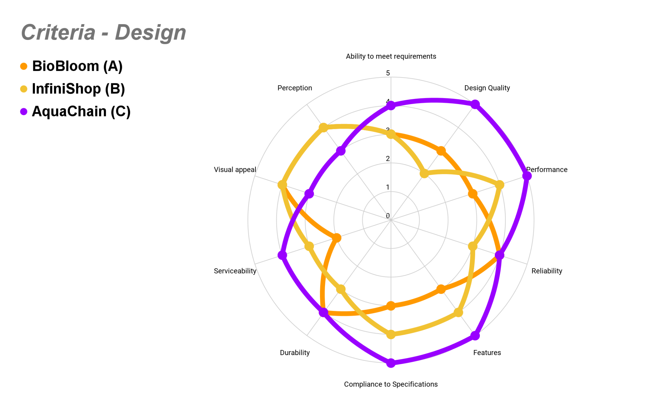
Design Parameters
Mihir

Slide 6
Input
Biobloom : Moderate
Infinishop : High
Aquachain : Moderate
Biobloom : High
Infinishop : Low
Aquachain : Moderate
Materials Availability
Cost of materials
Biobloom : Moderate
Infinishop : High
Aquachain : Moderate
Tooling
Biobloom : High
Infinishop : Low
Aquachain : Moderate
Software
Rachana & Shruti

Slide 7
Input
Complexity
Complexity
Equipment
Biobloom : High
Infinishop : Low
Aquachain : Moderate
Facilities
Biobloom : High
Infinishop : Low
Aquachain : High
Complexity
Staff
Biobloom : High
Infinishop : Moderate
Aquachain : High
Cost of Inputs
Biobloom : High
Infinishop : Low
Aquachain : High
For detailed input analysis : Detailed Inputs Analysis
Rachana & Shruti

Slide 8
Input Cost Comparison
Facilities Cost
Materials Cost
70%
Biobloom
50%
20%
40%
20 %
Infinishop
Aquachain
30 %
Biobloom
Facilities
Infinishop Facilities
Aquachain Facilities
Equipment Cost
70-80%
80%
60-70%
10-20%
60%
Rachana & Shruti

Slide 9





Transformation
Manufacturability
Cost of Manufacturing
Ease of Integration
Biobloom : High
Infinishop : Low
Aquachain : High
Biobloom : Low
Infinishop : Moderate
Aquachain : Low
Biobloom : High
Infinishop : Low
Aquachain : High
Staff & Management Competency
Infrastructure Readiness
Biobloom : High
Infinishop : Moderate
Aquachain : High
Biobloom : Moderate
Infinishop : Low
Aquachain : High
William

Slide 10




Output
Biobloom : Moderate
Infinishop : Low
Aquachain : High
Biobloom : Low
Infinishop : Moderate
Aquachain : High
Transportability
Logistics
Biobloom : Low
Infinishop : Moderate
Aquachain : High
Distribution Channels
Biobloom : Moderate
Infinishop : Low
Aquachain : High
Infrastructure
Patrick
Notes:
Patrick

Slide 11



Output
Cost of Maintenance
Biobloom : Moderate
Infinishop : Low
Aquachain : High
Customer Life Cycle Cost
Biobloom : High
Infinishop : Low
Aquachain : Moderate
Manufacturer Life Cycle Cost
Biobloom : Moderate
Infinishop : Low
Aquachain : High
For detailed output analysis : Output Analysis
Patrick

Slide 12

Output Cost Comparison
Cost of Maintenance
Customer Life Cycle Cost
20%
Biobloom
20%
10%
40%
20%
Infinishop
Aquachain
10%
Biobloom
Facilities
Infinishop Facilities
Aquachain Facilities
Manufacturer Life Cycle Cost
Miscellaneous
Biobloom : High
Infinishop : Moderate
Aquachain : High
80%
60%
80%
40%
For detailed output analysis : Output Analysis
Patrick
60%

Slide 13

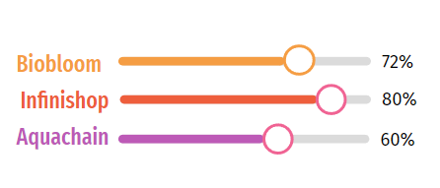
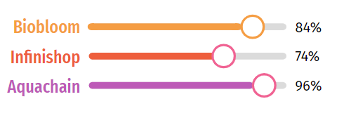
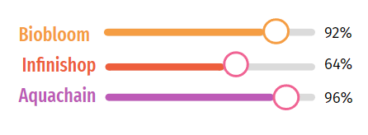
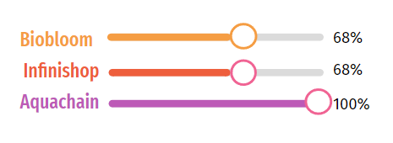
Downselect Criteria and Conclusion
Input
Potential Designs
Transformation
Output Intricacy
Rachana & Shruti

Slide 14
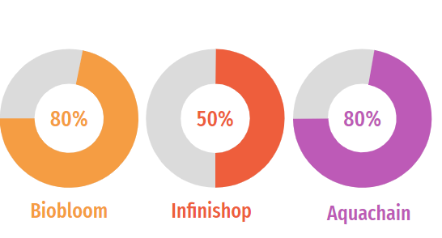
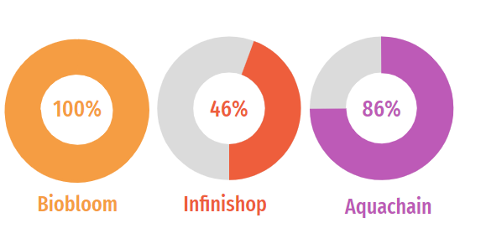
Downselect Criteria & Conclusion
Cost Comparison
Complexity Comparison
Rachana & Shruti

Slide 15

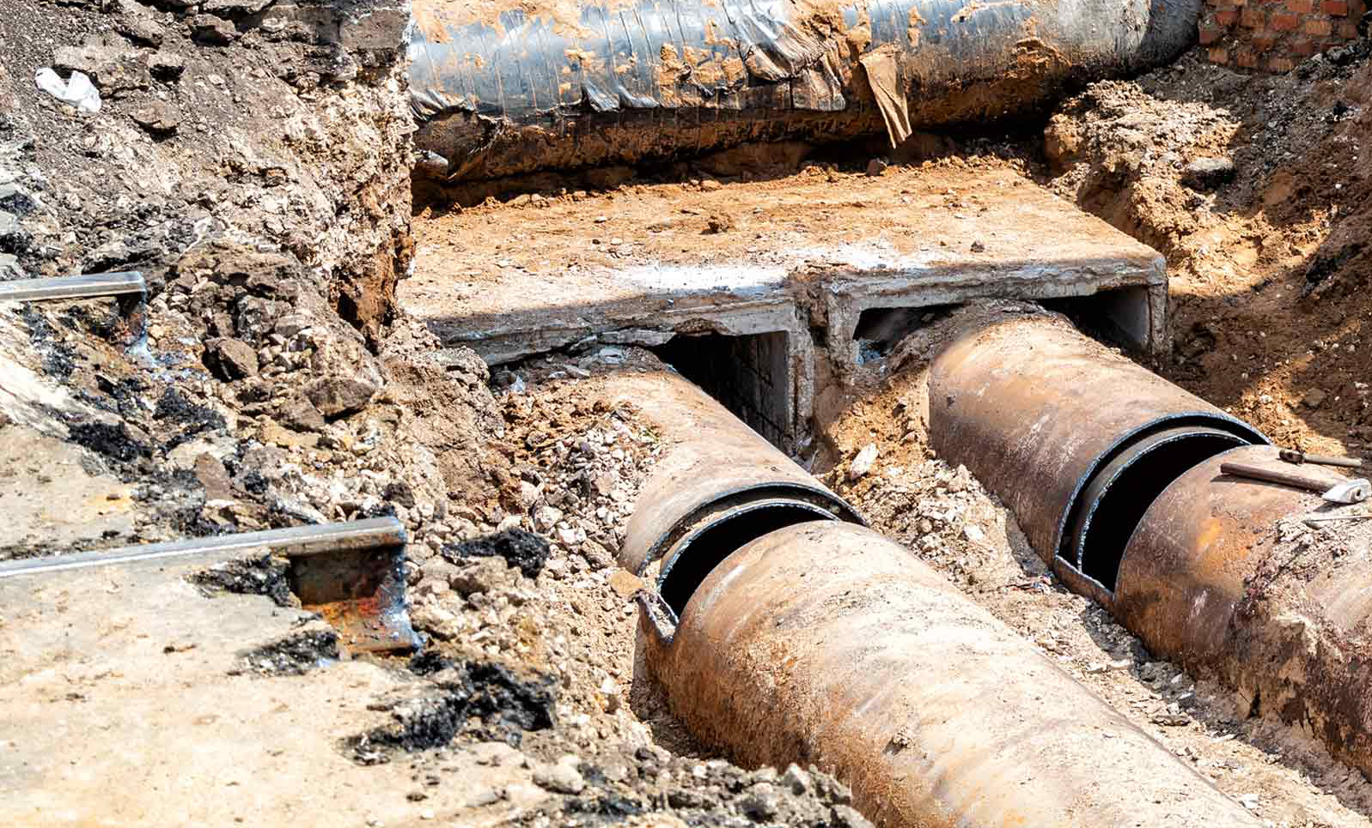

“Aqua Chain”
Aqua Chain has biggest Social impact and addresses
Fundamental human need , access to clean water, impacting billions globally.
Global crisis of water scarcity and poor water management.
Contributes to sustainability.
Whereas
Infinishop focuses on business objectives and Biobloom focuses on certain specialty areas and primarily benefits smaller groups of individuals.
Rachana & Shruti
Notes:
Average of categories, summarize (Rachana, William, Shruti)

Slide 16
References/ Appendix
1.https://carewater.solutions/en/waterborne-diseases/
2.https://www.bv.com/perspectives/aging-infrastructure-and-workforce-vexing-challenges-remain/
3.Downselect criteria https://docs.google.com/spreadsheets/d/1gQRXX5AbjdF8T2v8fkKlXB52i9hbKpvM/edit?usp=drive_link&ouid=101281950215166262772&rtpof=true&sd=true

